Slide 1
2024 carbon budget update and discussion
January 14, 2025

Slide 2
Methods summary
A/Ci curves on all individuals every two weeks
Half of individuals every week
We do not have repeat measures for all Mai throughout growing season due to trampling/tree shaving incident
Challenging for constructing carbon budget at individual scale

Slide 3
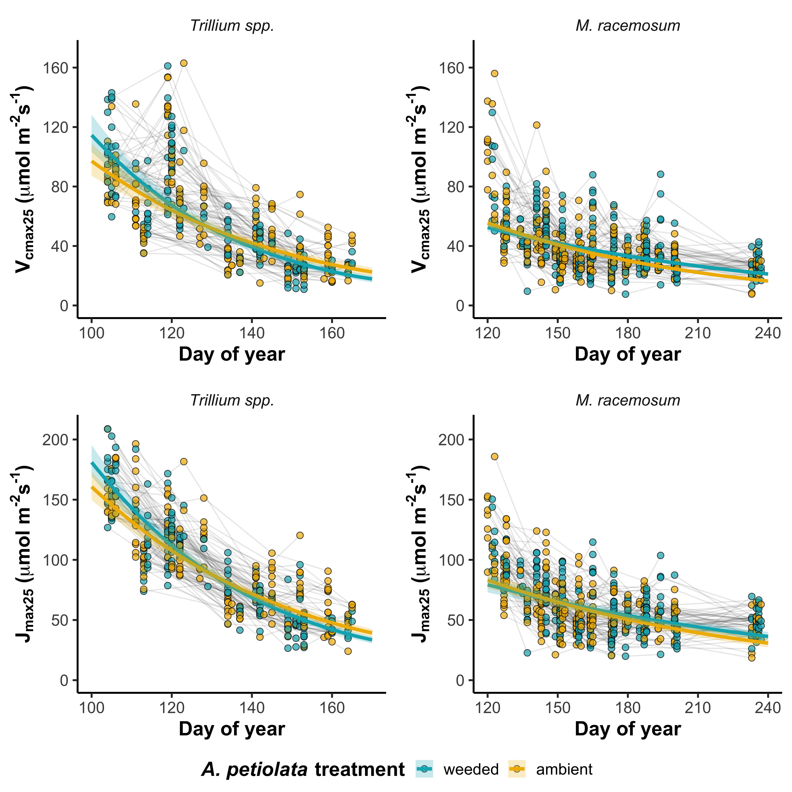
Solution (at least for C budget paper):
Bootstrap predictions for V_{cmax25}
J_{max25} for each day (n = 1000 iterations
for )

Slide 4
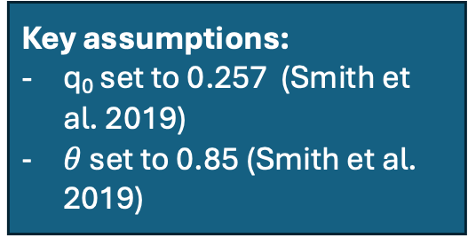
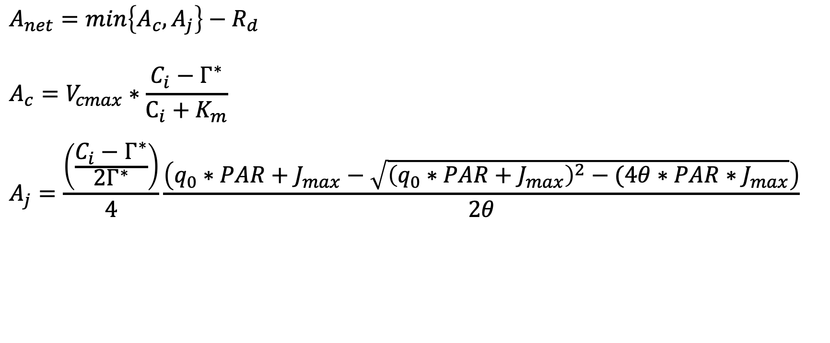
Photosynthesis model
Key assumptions:
q₀ set to 0.257 (Smith et al. 2019)
$θ$ set to 0.85 (Smith et al. 2019)
$$A_{net}=min\left\{A_{c}, A_{j}\right\}−R_{d}$$
$$A_{c}=V_{cmax}∗\frac{C_{i}−Γ^{∗}}{C_{i}+K_{m}}$$
$$A_{j}=\frac{\left(\frac{C_{i}−Γ^{∗}}{{2Γ}^{∗}}\right)}{4}\frac{\left(q_{0}∗PAR+J_{max}−\sqrt{{\left(q_{0}∗PAR+J_{max}\right)}^{2}−(4θ∗PAR∗J_{max}}\right)}{2θ}$$

Slide 5
Photosynthesis model
Key assumptions:
q₀ set to 0.257 (Smith et al. 2019)
$θ$ set to 0.85 (Smith et al. 2019)
$$A_{net}=min\left\{A_{c}, A_{j}\right\}−R_{d}$$
$$A_{c}=V_{cmax}∗\frac{C_{i}−Γ^{∗}}{C_{i}+K_{m}}$$
$$A_{j}=\frac{\left(\frac{C_{i}−Γ^{∗}}{{2Γ}^{∗}}\right)}{4}\frac{\left(q_{0}∗PAR+J_{max}−\sqrt{{\left(q_{0}∗PAR+J_{max}\right)}^{2}−(4θ∗PAR∗J_{max}}\right)}{2θ}$$
We can use daily estimates of V_{cmax}, J_{max}, and C_{i} (produced from model predictions) and hourly estimates of PAR and temperature (Γ* and K_{m} are functions of temperature) to estimate hourly C gain, then scale to daily C gain

Slide 6
Carbon budget approach (ignoring size classes for now)
Create models for V_{cmax}, J_{max}, C_{i}
Trait ~ gm_trt * doy + (1 | id)
Bootstrap model predictions using bootMER() to generate 1000 values of V_{cmax}, J_{max}, C_{i} for gm_trt for each day
Merge bootstrapped model predictions into hourly climate dataset (1000 rows of each trait per hour of each trait for each day)

Slide 8
For demography models
Relationship between size class and total C gain

Slide 9
Size classes
C budget model to be discretized to five size classes
Options:
Stdev of total leaf area scaled evenly across size classes
Number of individuals evenly distributed across size classes

